Slide 1
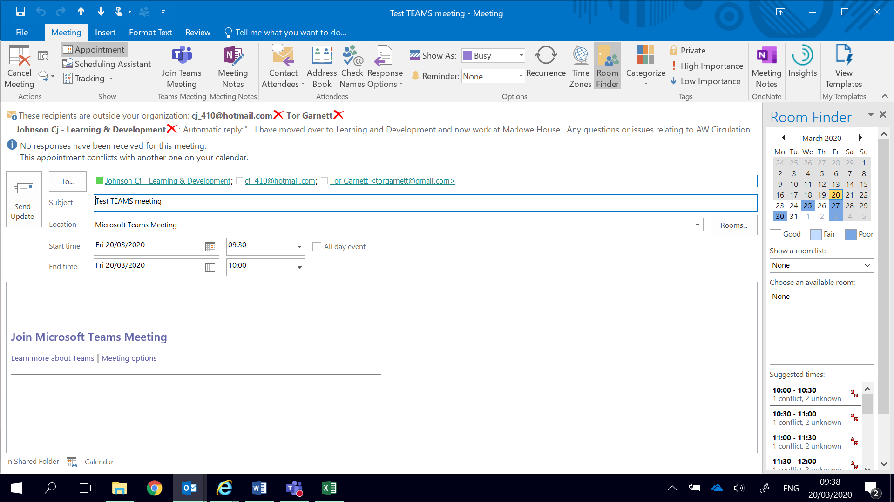
Microsoft Teams - External Participants
Press this to generate the purple teams link.
Copy and Paste external email addresses in here - separate them with a ;
Get the Subject of the lesson and the timings correct. Then press Send

Slide 2
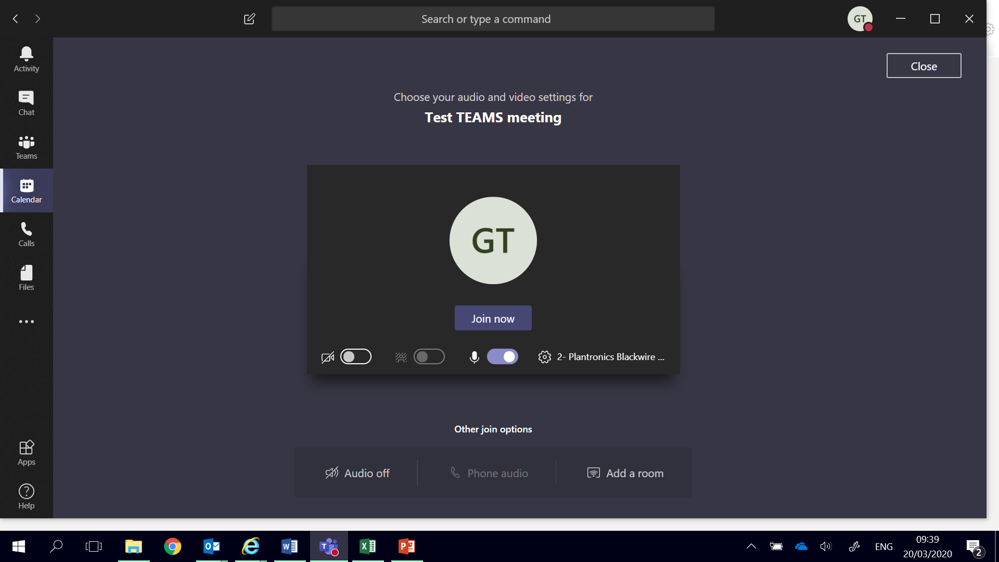
External Participants
At the meeting start time – click on the link in the calendar invite
Join as normal by pressing ‘join now’

